Slide 1

LOOK AT MEDIA
© 2014 Look At Media

Slide 2
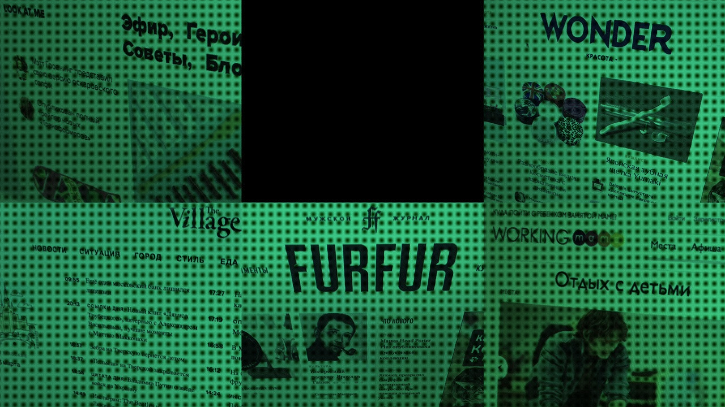





LOOK AT MEDIA
Creative industry lab
Riot girls
Site about big cities life
Modern and active moms club
Street culture
© 2014 Look At Media

Slide 3


Web-site about everything modern citizen can be interested in: culture, society, business, entertainment, travelling, food, services and people.
The Village distinguishing feature that differs it from other media projects is active position in creation of comfort environment for people in the cities
3 228 311
17 623 679
6 минут
MONTHLY
UNIQUE VISITORS
MONTHLY
PAGE VIEWS
AVARAGE
TIME SPENT
Google Analytics, December 2014 г.
© 2014 Look At Media
Notes:
17 591 721

Slide 4
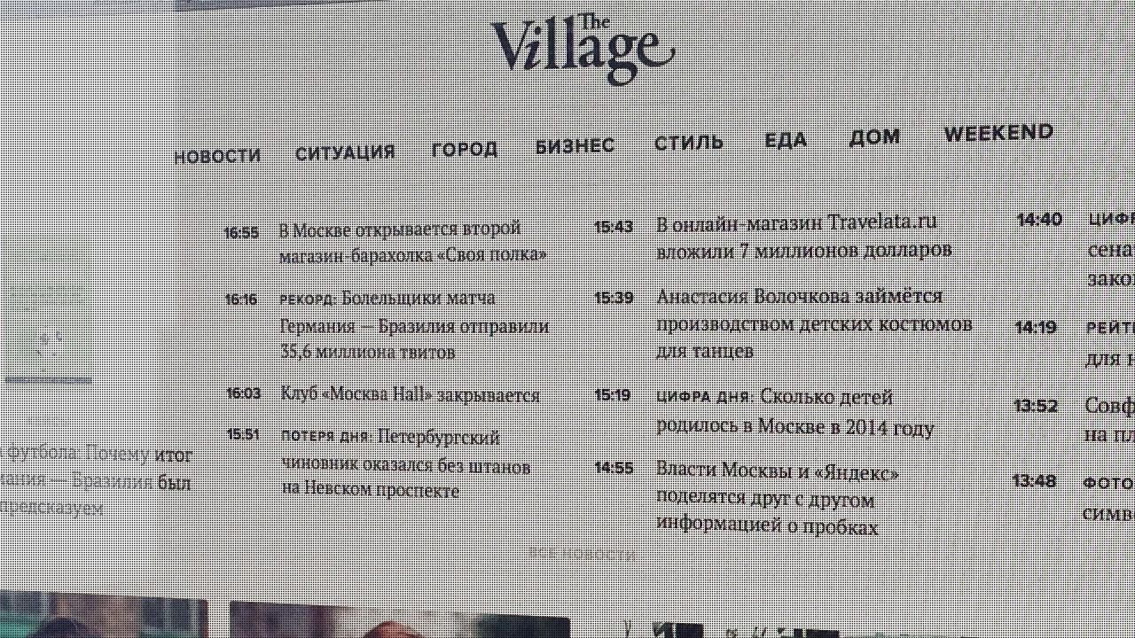
© 2014 Look At Media

Slide 5


Content columns
1
2
3
4
News
Case
City
Business
The most important
happening right now
Common urban situations
which city inhabitant
come across daily
Everything new happening in
Moscow, St. Petersburg and Kiev:
from infrastructure and transport
to new places and events
Source of ideas, inspiration
and all necessary information
for Russian businessmen
5
6
7
8
Style
Food
Home
Weekend
Fashion as the way of life
of a modern citizen
Encyclopedia of the best places, chefs, restaurants and recipes in the cities
Everything one should know
about housing: advice on repair and home decoration, best apartments in Moscow, St. Petersburg and Kiev
What to do and where to go
on the weekends
© 2014 Look At Media

Slide 6

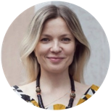


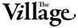
Audience
The core of the web-site audience are men and women aged from 25 to 34. They are modern citizens, who've succeeded in life somehow. They build career or held own business. They are not indifferent towards everything that happens in their city: follow new initiatives, take part in social life, try to apply foreign experience as well as interested in local culture. Their active lifestyle allows them to have a lot of friends and acquaintances
25-34 YEARS
THE CORE AUDIENCE
© 2014 Look At Media

Slide 7

Geo
Gender
Age
12 — 17
St.petersburg
Не работаю
18 — 24
25 — 34
others
women
men
35 — 44
MOSCOW
45 — 54
Работаю
55 — 64
© 2014 Look At Media
TNS Gallup, Russia 0+, December 2014
Google Analytics, December 2014

Slide 8

Source
новые читатели
Tablet
новые читатели
Tablet
Mobile
Desktop
Desktop
Mobile
Average
On weekend
© 2014 Look At Media
Google Analytics, December 2014

Slide 9
6 minutes
AVERAGE
TIME SPENT
38%
Have higher income that average
69%
Visit The Village
more than 3 times
a week
75%
Readers back to the site
© 2014 Look At Media
TNS Gallup, Russia 0+, December 2014
Google Analytics, December 2014

Slide 10
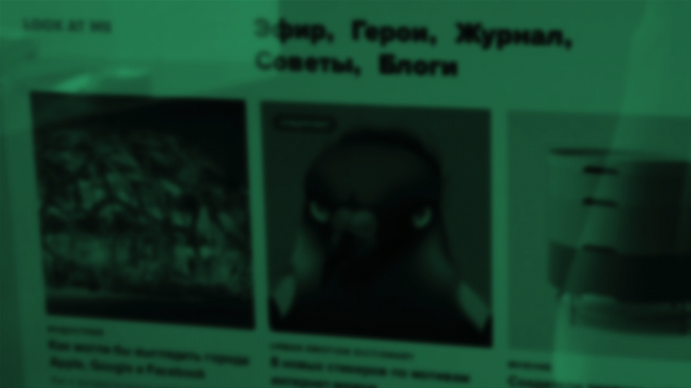
LOOK AT ME
Daily web-site for people who are keen of modern culture. From May 2013 Look At Me writes about secrets of different occupations: what to read, where to go, who to get the necessary skills, what technologies would help us in future
2 343 202
7 249 966
4 минуты
MONTHLY
UNIQUE READERS
MONTHLY
PAGE VIEWS
AVERAGE
TIME SPENT
Google Analytics, December 2014 г.
© 2014 Look At Media
Notes:
1 728 271
Просмотры страниц
5 863 892

Slide 11
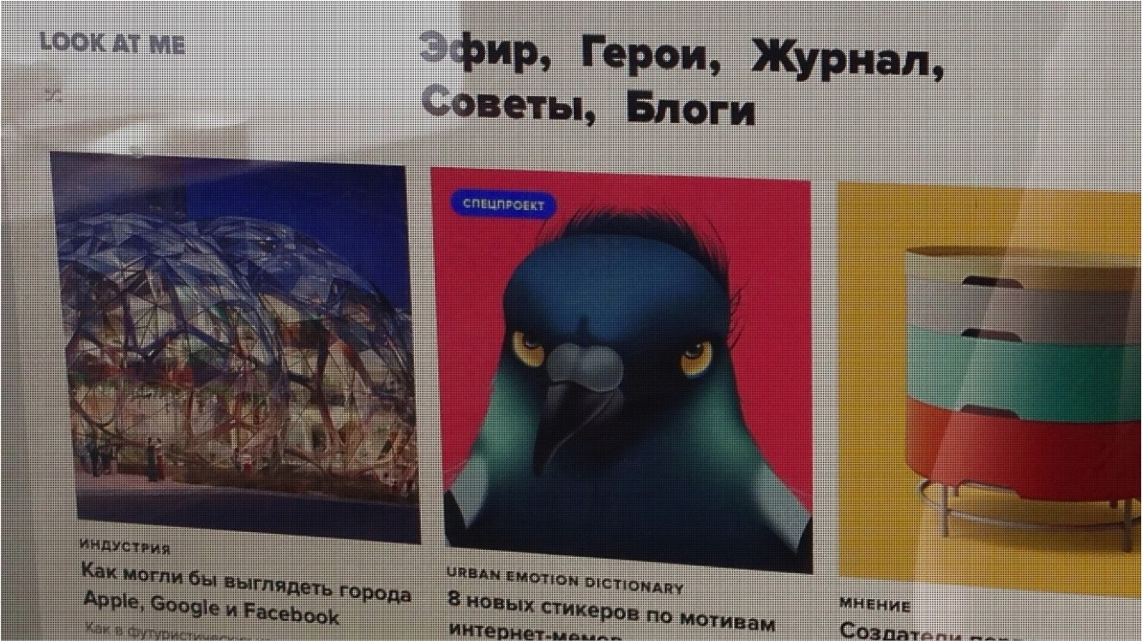
© 2014 Look At Media

Slide 12

LOOK AT ME
Content columns
Together all Look At Me materials represent the site approach: we've moved from watching to deep integration into the creative industries processes
1
2
3
Live
Heroes
Tips
Fast reaction to what's happening in the world right now
The most interesting things about the people who we consider iconic
Answer to all the questions
young people today care for:
what to be? what to buy?
how to do better?
4
5
Mag
Blogs
Regular topical special project
Private editors and contributors
blogs, as well as the most
interesting events
announcements
© 2014 Look At Media

Slide 13



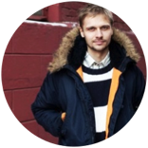
LOOK AT ME
Audience
Creative intellects, adult people aged from 25 to 35 who've succeeded in life somehow. The majority are the representatives of creative professions as well as business owners and media personalities. Very often their opinion affects other people views
Part of the web-site audience are young specialists aged 18-24. They are the most progressive part of russian youth, who live primary in big cities, know and understand what they want from life
25-34 YEARS
THE CORE AUDIENCE
© 2014 Look At Media

Slide 14
LOOK AT ME
Geo
Gender
Age
st..petersburg
12 — 17
Не работаю
18 — 24
25 — 34
moscow
others
WOMEN
MEN
35 — 44
45 — 54
Работаю
55 — 64
© 2014 Look At Media
TNS Gallup, Russia 0+, December 2014
Google Analytics, December 2014

Slide 15
LOOK AT ME
Source
новые читатели
Tablet
Mobile
Tablet
Desktop
Desktop
Mobile
Average
On weekend
© 2014 Look At Media
Google Analytics, December 2014

Slide 16
LOOK AT ME
4 minutes
AVERAGE
TIME SPENT
44%
Have higher income that average
50%
Visit Look At Me
more than 3 times
a week
57%
Readers back to the site
© 2014 Look At Media
TNS Gallup, Russia 0+, December 2014
Google Analytics, December 2014

Slide 17


Daily web-site founded in 2011 as well as strong readers community. The web-site covers all the interests of the modern person living in a big city, especially style
and street culture
1 053 306
4 762 390
6 минут
MONTHLY
UNIQUE READERS
MONTHLY
PAGE VIEWS
AVERAGE
TIME SPENT
Google Analytics, December2014 г.
© 2014 Look At Media
Notes:
1 067 277
Просмотры страниц
7 365 040

Slide 18
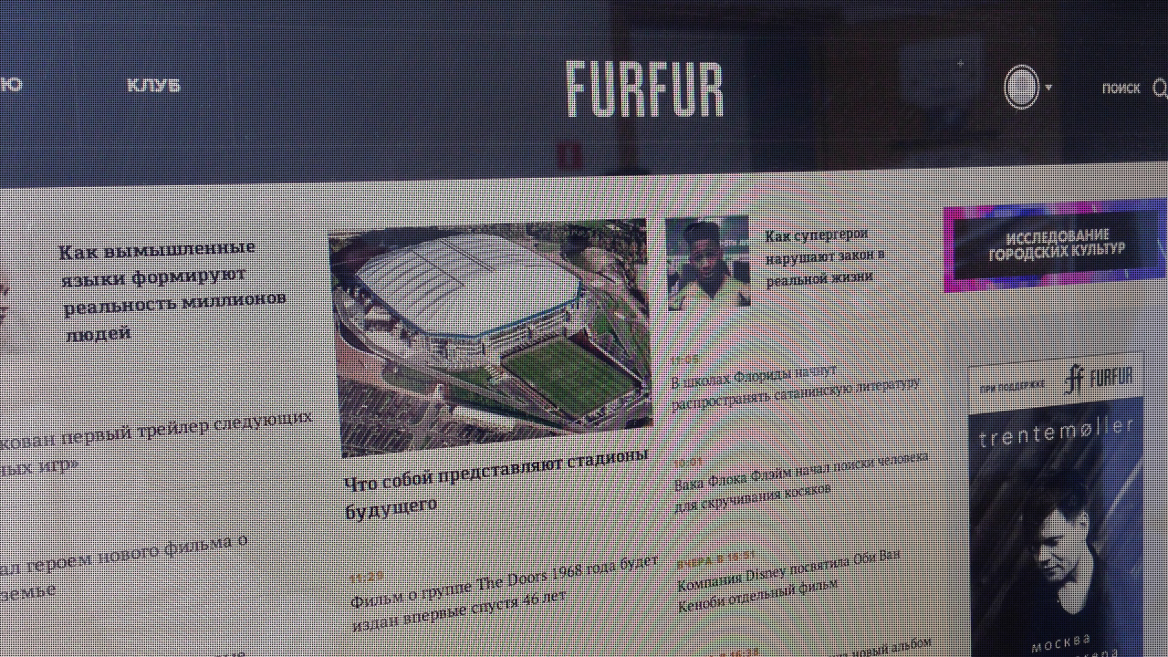
© 2014 Look At Media

Slide 19


Content columns
1
2
3
4
Style
Sex
Experiments
Club
Street style in details
Girls, boys and everything one
need to know about modern relationships
Different editorial and readers experiments beginning with iPod disassembling ending with serigraphy at home
Discussion forum for any
interesting issue
5
6
7
Heroes
Market
Culture
Stories about true people
Furfur readers look up to
Sell and buy cool projects
from each other
Traveling, motorbikes, music and movies together with comprehensive guides on modern culture
© 2014 Look At Media

Slide 20


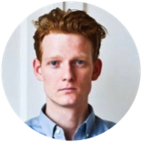


Audience
Young trendy women and men aged from 18 to 34 years old. The majority of them have permanent work and long-standing life views. They dress with care and mind what happens all around. They travel a lot and have wide friend circle
18-34 YEARS
THE CORE AUDIENCE
© 2014 Look At Media

Slide 21
Geo
Gender
Age
st..petersburg
12 — 17
Не работаю
18 — 24
25 — 34
moscow
others
women
men
35 — 44
45 — 54
Работаю
55 — 64
© 2014 Look At Media
TNS Gallup, Russia 0+, December 2014
Google Analytics, December 2014

Slide 22
Source
новые читатели
Tablet
Mobile
Tablet
Desktop
Desktop
Mobile
Average
On weekend
© 2014 Look At Media
Google Analytics, December 2014

Slide 23
6 minutes
AVERAGE
TIME SPENT
46%
Have higher income that average
65%
Visit FURFUR
more than 3 times
a week
62%
Readers back to the site
© 2014 Look At Media
TNS Gallup, Russia 0+, December 2014
Google Analytics, December 2014

Slide 24


Web-site for women who don't read glossy magazines. Style without glossy, relationships without complications and life without clichés
1 113 319
4 929 115
6 минут
ЕЖЕМЕСЯЧНАЯ
УНИКАЛЬНАЯ АУДИТОРИЯ
MONTHLY
PAGE VIEWS
AVERAGE
TIME SPENT
Google Analytics, December 2014 г.
© 2014 Look At Media
Notes:
862 618
3 306 966

Slide 25
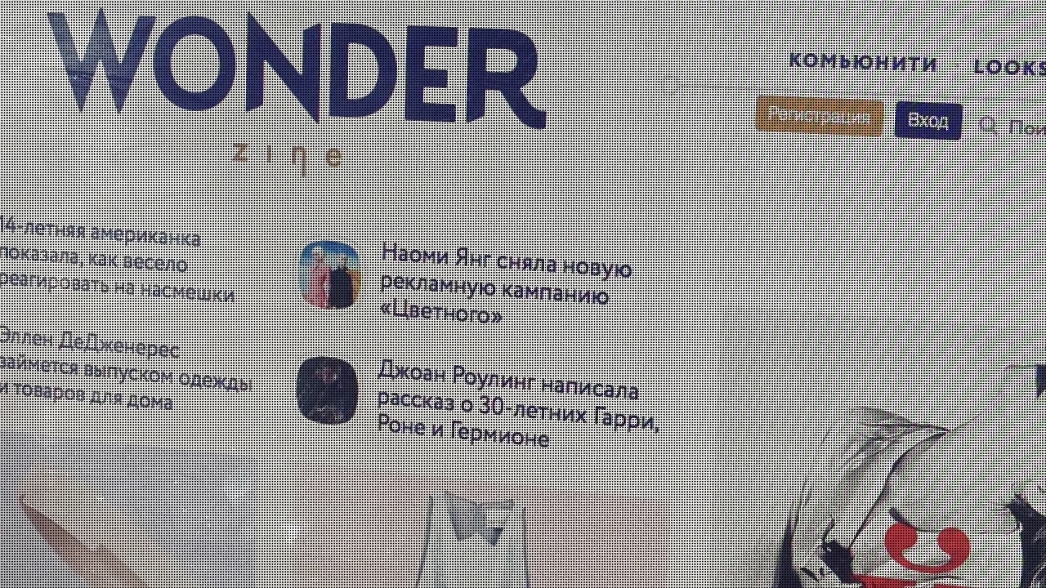
© 2014 Look At Media

Slide 26


Content columns
1
2
3
Style
Beauty
Life
Live discussion on city
fashion today
Everything a progressive lady
should know about make-up,
perfumes, fitness and
healthy lifestyle
Interesting people life principles,
men view on relationships,
modern lady hobbies, etc.
4
Entertainment
Movies, festivals, concerts, series and
expositions which one never finds
on other women resources
© 2014 Look At Media

Slide 27



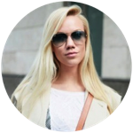
Audience
Women who live in big cities aged from 20 to 40. The core of the audience are modern ladies aged 25-34 years old. Their life is a fusion of career, relationships, dating, traveling, cultural and social life. They are not only stylish, but choosy and critical so they prefer quality products and entertainment. They lead very active life and have a lot of friends and acquaintances.
25-34 YEARS
THE CORE AUDIENCE
© 2014 Look At Media

Slide 28
Geo
Gender
Age
st..petersburg
12 — 17
Не работаю
18 — 24
25 — 34
moscow
others
women
men
35 — 44
45 — 54
Работаю
55 — 64
© 2014 Look At Media
TNS Gallup, Russia 0+, December 2014
Google Analytics, December 2014

Slide 29
Source
новые читатели
Tablet
Tablet
Mobile
Desktop
Desktop
Mobile
Average
On weekend
© 2014 Look At Media
Google Analytics, December 2014

Slide 30
5,5 minutes
AVERAGE
TIME SPENT
46%
Have higher income that average
61%
Visit Wonderzine
more than 3 times
a week
60%
Readers back to the site
© 2014 Look At Media
TNS Gallup, Russia 0+, December 2014
Google Analytics, December 2014

Slide 31


Trendy and active moms' club which helps them to find the most interesting and trendy places and events for kids in Moscow and St.Petersburg
129 707
250 021
2 минуты
MONTHLY
UNIQUE READERS
MONTHLY
PAGE VIEWS
AVERAGE
TIME SPENT
*Google Analytics, December 2014
© 2014 Look At Media

Slide 32
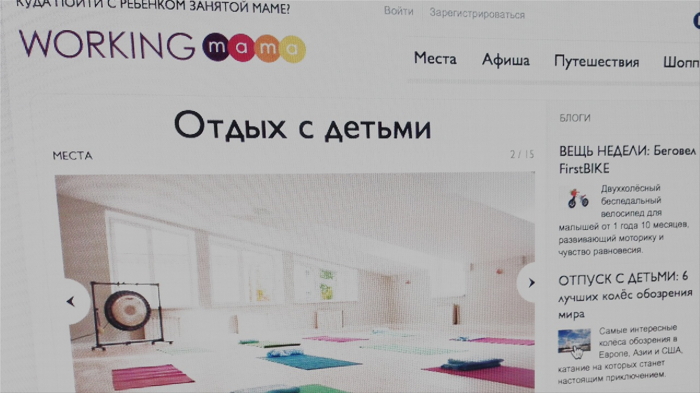
© 2014 Look At Media

Slide 33


Content columns
1
2
3
4
Places
Calendar
Travelling
Shopping
The most interesting people to go to with kids
Best events for kids from 0 year old and older
Where to go with a kid when you are abroad. Best places to go with the whole family
Best products for kids
5
6
7
News
Blogs
Working Moms
Hot info on what's going on in the ”moms & kids'" world
Detailed overview of best places and events
Interviews with the most active and respectful working mothers
© 2014 Look At Media

Slide 34

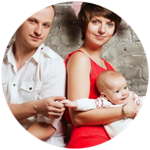
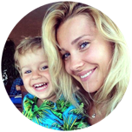
Audience
Trendy and progressive women aged from 18 to 40 years with kids from 0 to 12 years old. They build their career and have high income which allows them to go out and travel regularly. They are active consumers of products and services for children.
22-34 YEARS
85%
THE CORE AUDIENCE
MOSCOW AND ST.PETE
© 2014 Look At Media

Slide 35



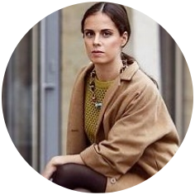
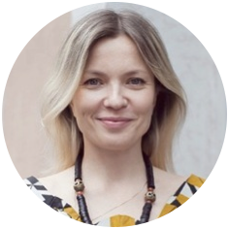





Audience portraits LOOK AT MEDIA
25-34
18-34
25-34
25-34
22-34
Creative industries
representatives
Trendy young people living in big cities
Young women
Big cities citizens
Active moms
© 2014 Look At Media

Slide 36


adv@lookatme.ru

